Slide 1
Software Analytics Talk 4
Joydeep (Mt2013062)

Slide 2
Topic
Cross-project Defect Prediction A Large Scale Experiment on Data vs. Domain vs. Process By:
Thomas Zimmermann Nachiappan Nagappan Harald Gall Emanuel Giger
Brendan Murphy

Slide 3

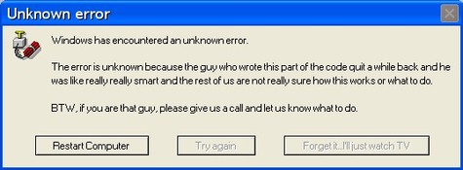

Slide 4

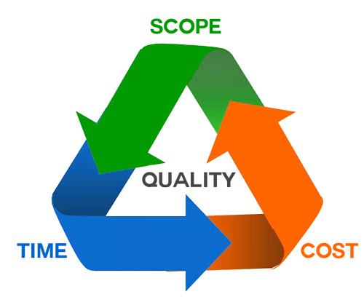
Notes:
Code n fix model

Slide 5
Defect prediction
Learn prediction model from historical data.
Predict defects for the same project.
Hundreds of prediction models exists.
Models work fairly well with a precision of 80%.
Notes:
Normal decision tree : bifurcation around gini index/ entropy

Slide 6
Abstract
Prediction of software defects works well within projects as long as there is a sufficient amount of data available to train any models.
What will happen if the company is new or the its first release of the product ?
To help the engineers in transferring prediction models from one project to another.
This will lead to better software development.

Slide 7
Introduction
Driving factors of defect prediction --Large amount of data to train the model (In general its not available).
Why not use data from other companies or projects to successfully predict defects in their own project.
Term coined cross-project defect prediction

Slide 8
Introduction…
The specific questions that are address are:
To what extent can we use cross-project data to predict post-release defects for a software system?
What kinds of software systems are good cross-project predictors—projects of the same domain, or with the same process, or with similar code structure, or of the same company?
Considering that within companies, the process is often similar or even the same, we seek conclusions about which characteristics facilitate cross-project predictions better—is it the same domain or the same process?

Slide 9
Introduction…
To test the hypotheses they conducted a large scale experiment on several versions of open source systems from Apache Tomcat, Apache Derby, Eclipse, Firefox as well as seven commercial systems from Microsoft, namely Direct-X, IIS, Printing, Windows Clustering, Windows File system, SQL Server 2005 and Windows Kernel.
For each system they collected code measures, domain and process metrics, and defects and built a defect prediction model based on logistic regression.
Next they ran 622 cross-projects experiments and recorded the outcome of the predictions, which they then correlated with similarities between the projects.
Notes:
Between 11c2 and 11c3

Slide 10
First experiment Firefox and IE
Firefox can predict defects in IE
IE cannot predict defects in Firefox.
Why?
Firefox
IE
P = 0.76, R = 0.88
P = 0.54, R = 0.04
Notes:
Investigate whether the similarities of the web browser domain overrule the different development processes and corporate cultures, and whether Firefox and Internet Explorer still can be used to predict each other’s defects.

Slide 11
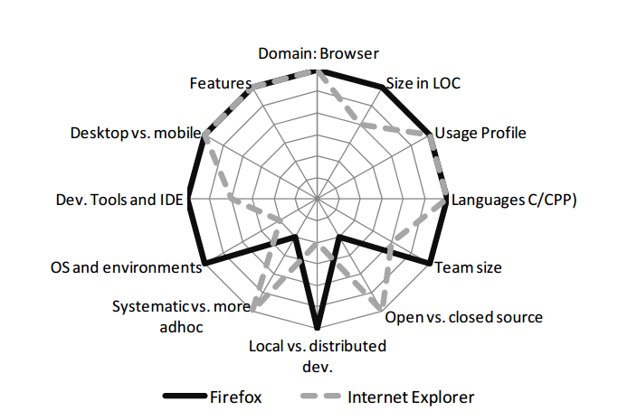
Comparing firefox and IE

Slide 12
Experiment outline
12 systems with 28 data sets different versions different levels of analysis(component files)
Run all 622 cross project combinations like IE and firefox is one combination train the model with IE data and test on firefox Ignore invalid combinations
Notes:
(A, B) to train a model from A to predict B if and only if the products of A and B are different or B is a later version than A. For example, Eclipse 2.0 to predict Eclipse 2.1 and later, but we did not use Eclipse 2.1 to predict Eclipse 2.0

Slide 13
Experiment outline
For each combination, record
Similarities between projects
Accuracy, precision and recall values
Success, if all accuracy, precision ,recall >0.75

Slide 14
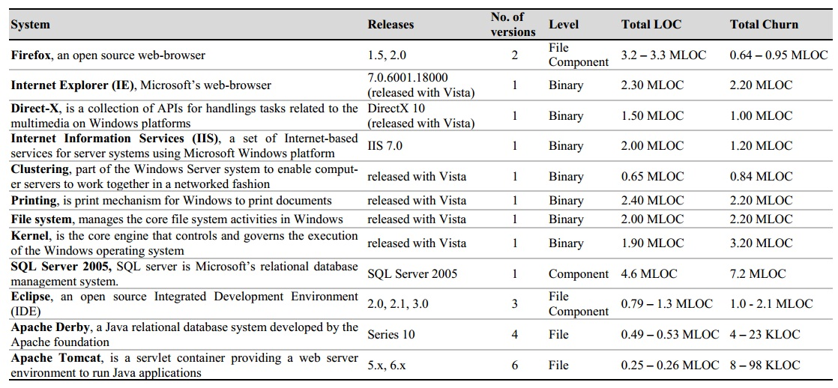

Slide 15
Data used in prediction models
Relative code measures in churn, complexity and pre-release bugs.
Added LOC/Total LOC
Deleted LOC/Total LOC
Modified LOC/Total LOC
Added LOC + modified LOC + deleted LOC /(Commits +1)
Cyclomatic complexity / total LOC
Pre-release bugs/ total LOC
Notes:
Added LOC/Total LOC: possibility of new features being written in the file/binary. Deleted LOC/Total LOC: whether significant functionality has been removed from the files/binary.(without checking for code dependencies) Modified LOC/Total LOC: account primarily for bug fixes (It measures the extent to which lines of code are modified with respect to the overall file/binary size) Pre-release bugs/Total LOC: This measure serves as a cross check with the Deleted LOC/Total LOC and Modified LOC/Total LOC so that if a bug fix in a particular file was to delete a few lines of code, predictors are able to withstand the variation in the metric values. (Added + Modified + Deleted LOC) / (Commits+1): This measure quantifies the extent of overall work done in a file/binary per check-in
Cyclomatic complexity/Total LOC: With this measure we get a relative estimate of the complexity of the binary/file (code quality)

Slide 16
Results
Success Rate = 3.4%

Slide 17
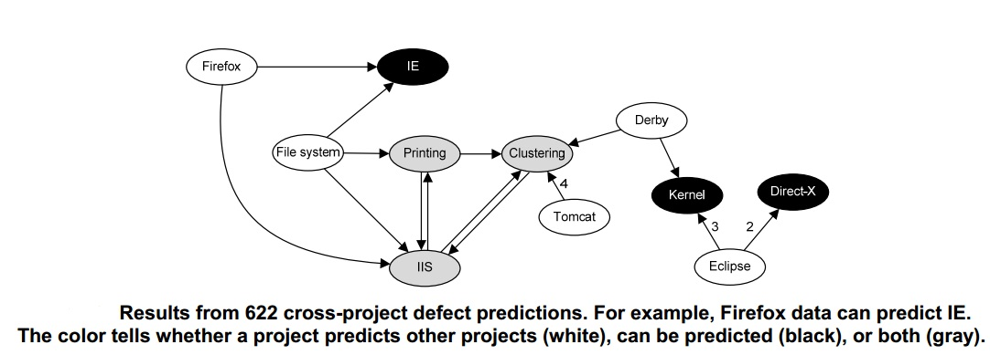
Successful cross project predictions

Slide 18
Characterizing projects
Domain
Domain Name
Product uses database
Product is localized
Type of user interface

Slide 19
Characterizing projects
Domain | Product
Domain Name | Name
Product uses database | Company intend audience
Product is localized | OS
Type of user interface | Programming Language
 | Single prog Language
 | Project uses c/c++
 | Project uses C#
 | Project uses Java
 | Project versions

Slide 20
Characterizing projects
Domain | Product | Process | Data
Domain Name | Name | Open source | Level of analysis
Product uses database | Company intend audience | Global development | No of observation
Product is localized | OS | Code reviews | Mean , SD of observation
Type of user interface | Programming Language | Static checkers
 | Single prog Language | No of developers
 | Project uses c/c++
 | Project uses C#
 | Project uses Java
 | Project versions

Slide 21
Comparing projects
If characteristic is ‘domain’, ‘product’, ‘programming languages’ and ‘level of analysis’ -- Same , Different
If nominal (for e.g. open source) -- Both X, Both Y , Both Z, …, different
If numeric (for e.g. LOC) --Less. Same, More

Slide 22
Comparing projects
characteristics
projects | domain | Open source | Code reviews | LOC
Train: Firefox | Browser | Yes | Yes | 3.2M
Test : IE | Browser | No | Yes | 2.3M
Similarity | ? | ? | ? | ?
Similarity | Same | different | Both Yes | Less

Slide 23
Comparing projects…
Similarity | Same | different | Both Yes | Less
How precision, recall and accuracy related to these??????

Slide 24
Influence of individual factors
For each characteristic and level --check with t-test, whether they influence P, R , A?
Possible effect on P, R, A --Increase --decrease --No significant effect.

Slide 25
characteristics
projects | domain | Open source | Code reviews | LOC
Train: Firefox | Browser | Yes | Yes | 3.2M
Test : IE | Browser | No | Yes | 2.3M
Similarity | Same | different | Both Yes | More
Accuracy UP
Precision Down
Recall UP Precision UP
Accuracy Down
Recall UP Accuracy down

Slide 26
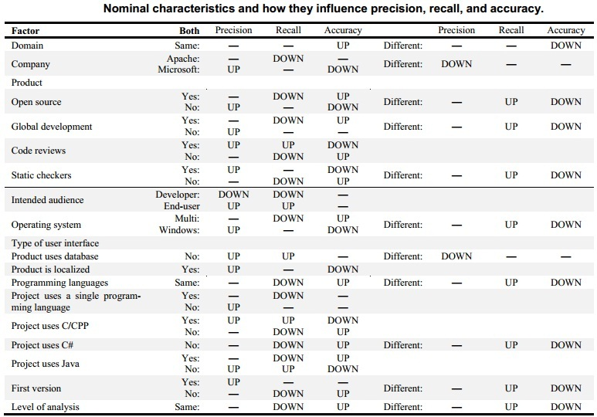

Slide 27
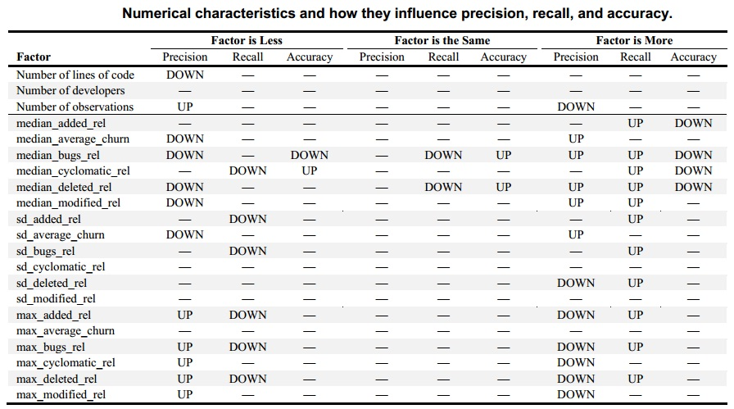

Slide 28
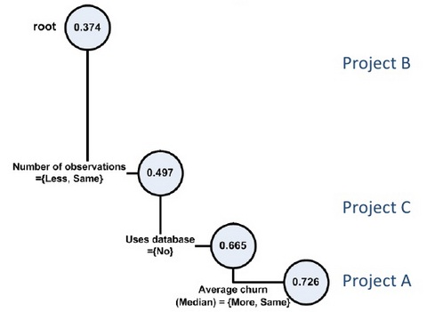
Decision tree for precision

Slide 29
Conclusion
Empirical evidence that cross-project prediction is a serious problem. That is, simply using projects in the same domain does not work to build accurate prediction models. Process, data and domain need to be quantified, understood and evaluated before prediction models are built and used.
An approach for identifying factors that influence the success of cross-project predictions. Software engineers can this technique to locate projects for building cross-project predictors. Though the study uses 12 different real world applications, as with all empirical studies, the study will need to be replicated with more projects, different metrics, and more project characteristics.

Slide 30
Future work
Replicate : more projects + characteristics
Address further research questions --Why are cross project predictions non-transitive? -- How does the set of matrices effect the prediction?

Slide 31
Road Map Of Software Analytics in this RE
Talk 1 (Abstract)
Talk 2 (Introduction)
Talk 3 (Application)
Talk 4 (Need of enhancements)

Slide 32
Thank you

